Slide 1

Cerebrovascular Disease in Scotland Statistics and Modeling
Fiona Carson
February 2023

Slide 2
Outline
Introduction
Cerebrovascular disease (CVD)
Relevant statistics
Data
Types of CVD – discharge and mortality data
Age
Sex
Geographic area
Can we predict future CVD rates?
Could put logos for R packages used on relevant page

Slide 3
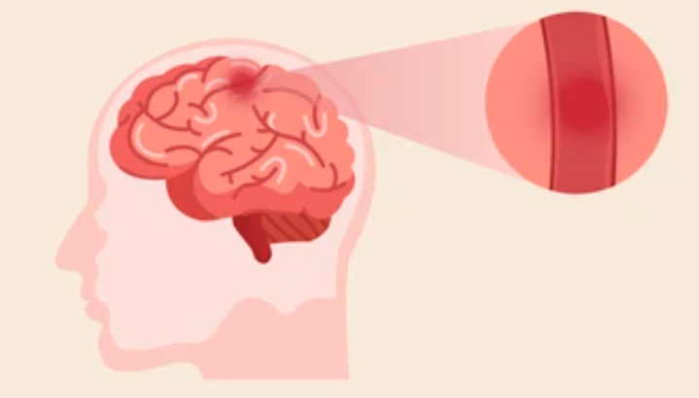
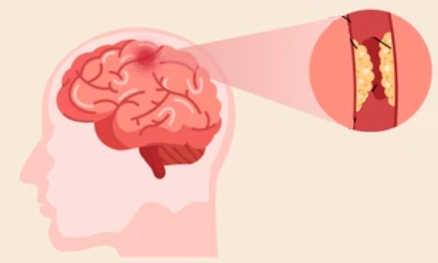
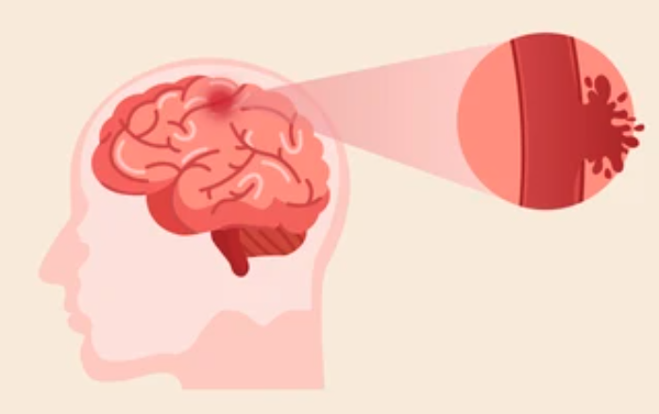
Introduction – Cerebrovascular Disease
Result of problems with the blood vessels supplying the brain
Types of CVD in the PHS data
Stroke - area of brain is deprived of blood supply because of a blockage usually by fatty deposits or a blood clot
Transient ischaemic attach (TIA) - temporary form of stroke (“mini-stroke”), symptoms generally last less than 24 hours
Subarachnoid haemorrhage - a leak of blood caused by the rupture of a blood vessel beneath the membrane covering the brain (type of brain haemorrhage)
Other CVD – incidences which don’t fall into above categories
Blood clot
Fatty deposits
Haemorrahage
Notes:
Cerebrovascular disease (CVD) - condition that develops as a result of problems with the blood vessels supplying the brain.

Slide 4
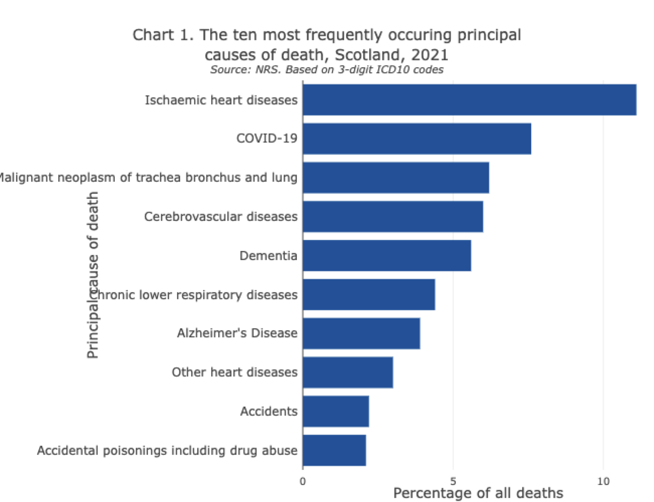
Introduction – CVD in Scotland
3826 deaths in Scotland in 2021 where CVD was underlying cause
130,000 people living in Scotland have survived a stroke or TIA
>50% of stroke survivors are under 75
Prevalence rates for stroke in most deprived areas of Scotland are more than twice those in the least deprived areas
Also have .csv with leading death rates by council area – could show some of most deprived council areas have it as higher cause of death
References: https://www.scotpho.org.uk/population-dynamics/deaths/data/most-frequent-causes/
British Heart Foundation - Global Heart & Circulatory Disease Factsheet Feb 2023
Notes:
130,000 is 2.4% of population

Slide 5
Introduction – CVD Data
Includes the “COVID years”!!
2009
2018
2021
Data from PHS Scotland
Discharges
Mortality
Raw data – number of discharges
Crude rates – discharges per 100,000 population
EASR – discharges adjusted to European Standard Population to account for age and sex differences in different places
}
Health Board and Council Area
Discharges
Complicated statistic
less people dying, more being discharged
more people suffering CVD
Notes:
One patient can have more than one discharge from hospital within a given time period.
Figures on discharges provide an indication of hospital usage for the diagnosis and treatment of cerebrovascular disease in either an inpatient or day case setting but exclude activity relating to outpatients.
Looked at incidences but it is not as relevant as I thought as it screens out anyone who has had any stroke related admission in the last 10 years.
Incidence data was sources from excel files related to the PHS Stroke report but these only sub-categorised cerebrovascular disease and stroke.

Slide 6
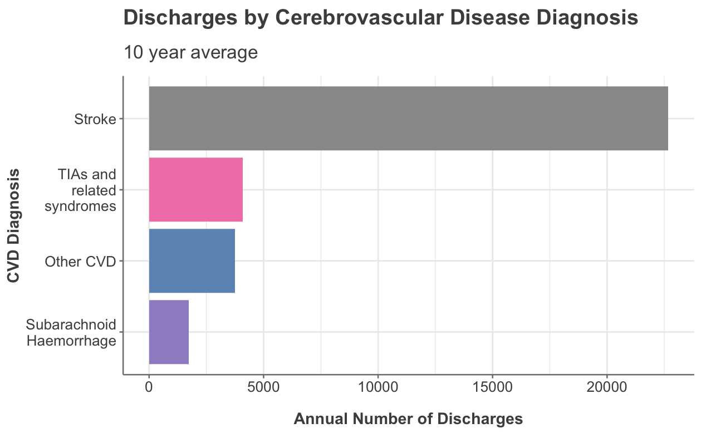
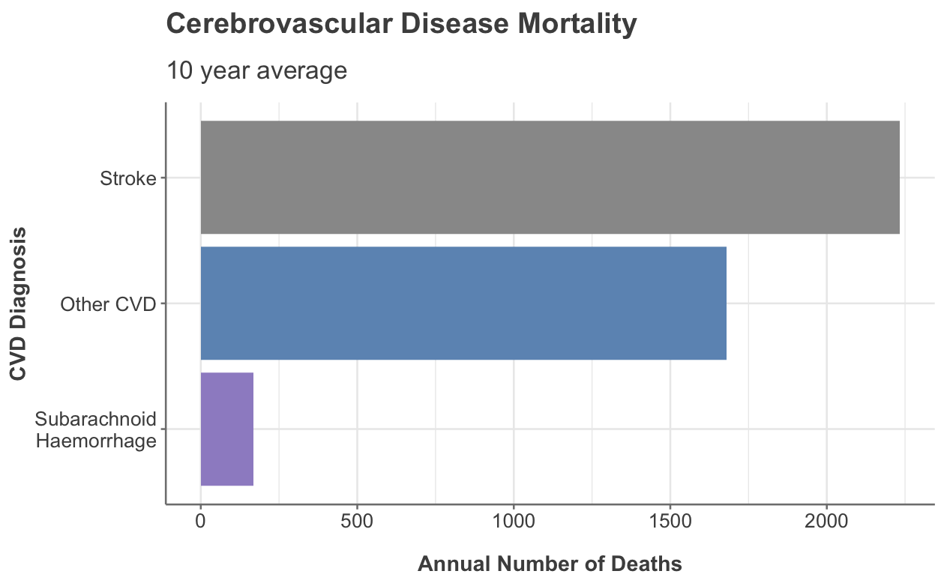
Most Common Type of CVD
TIAs are included in ‘Other CVD’ for mortality data
The raw values have been used (no population or age standardisation)
Notes:
Other CVD includes “sequelae of CVD” – perhaps this accounts for the high number of deaths

Slide 7
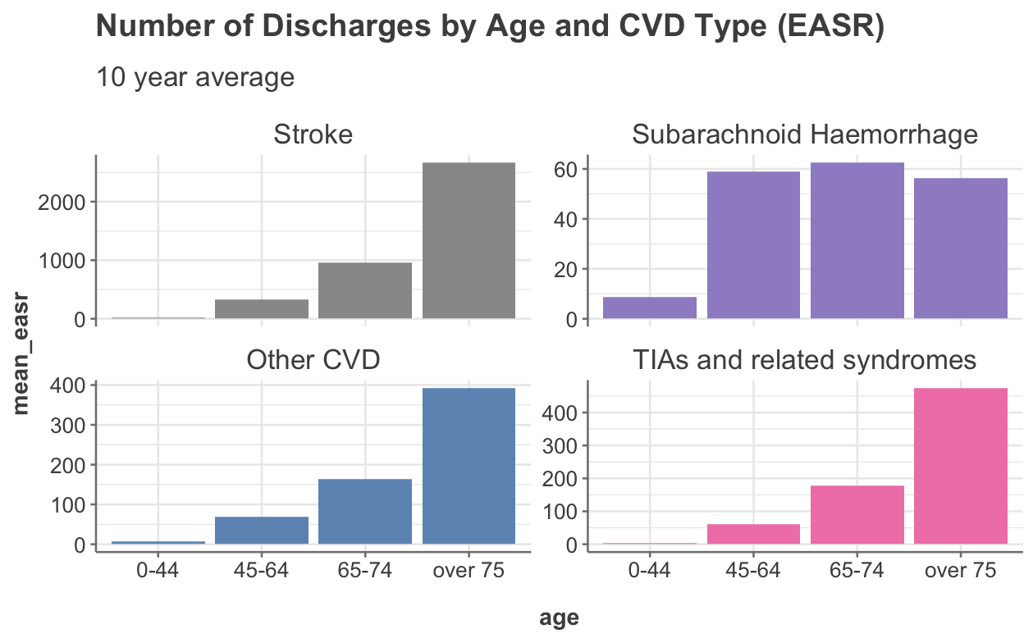
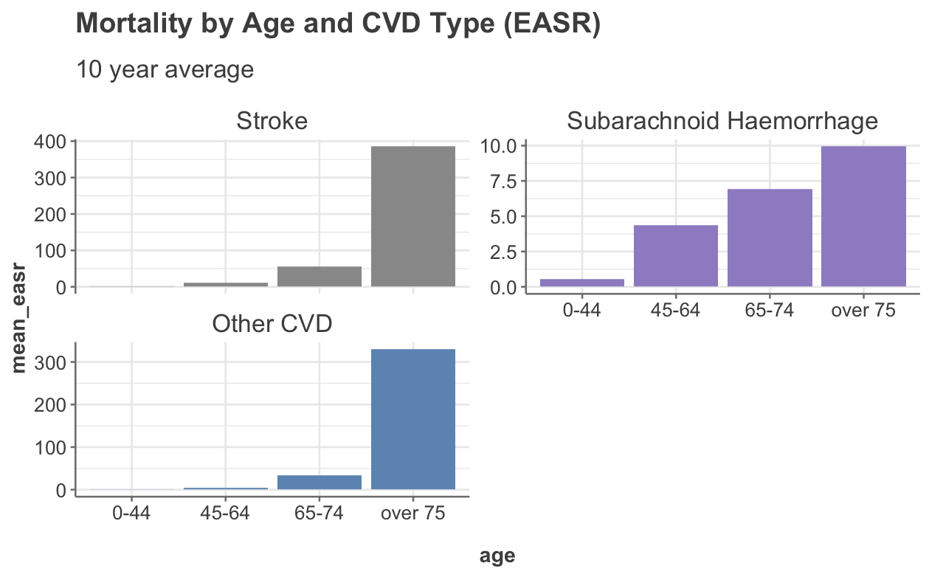
Type of CVD by Age
Now we are looking at EASR data
Discuss results
Notes:
Looked at incidence data – shows same pattern

Slide 8
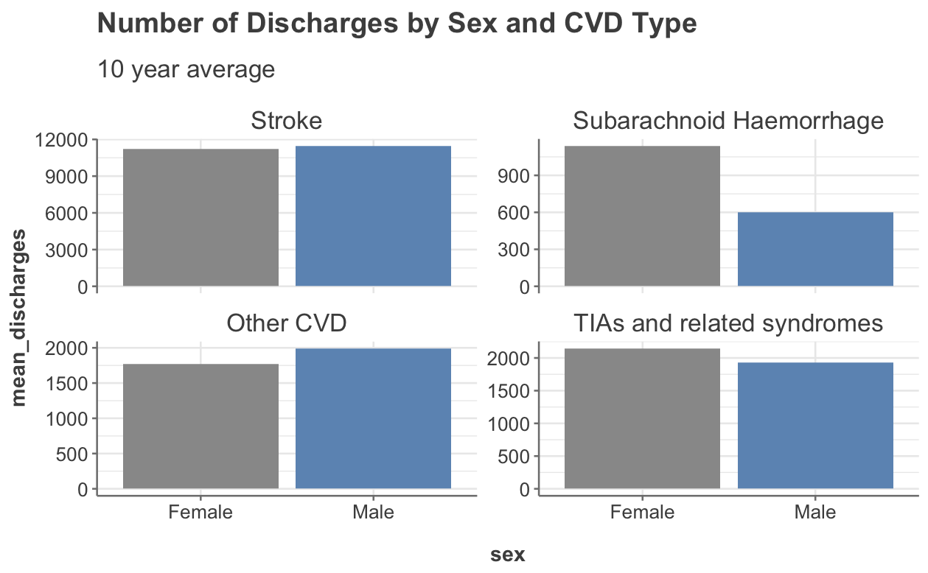
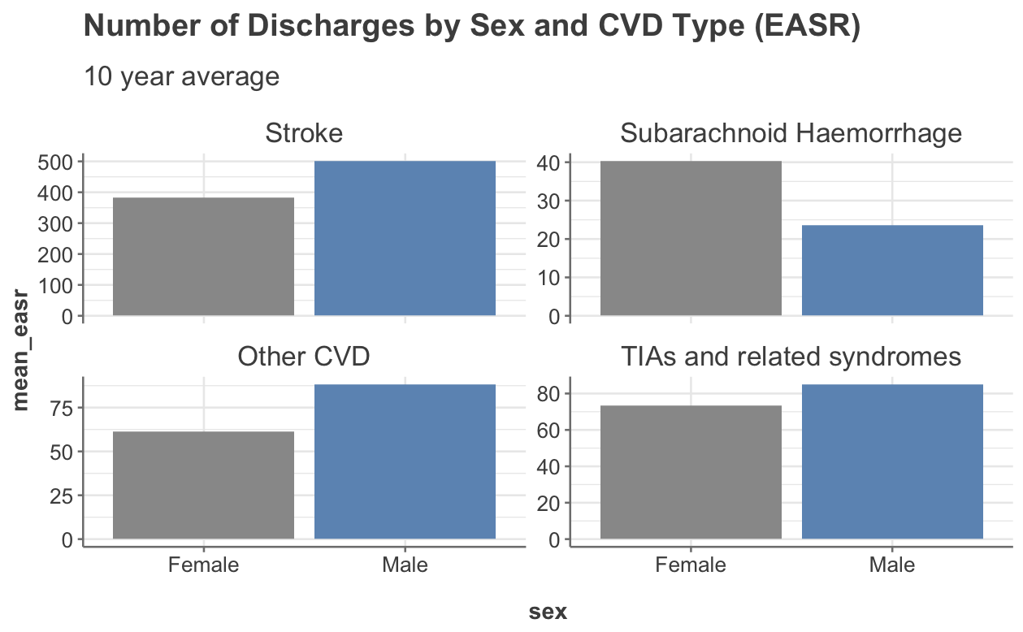
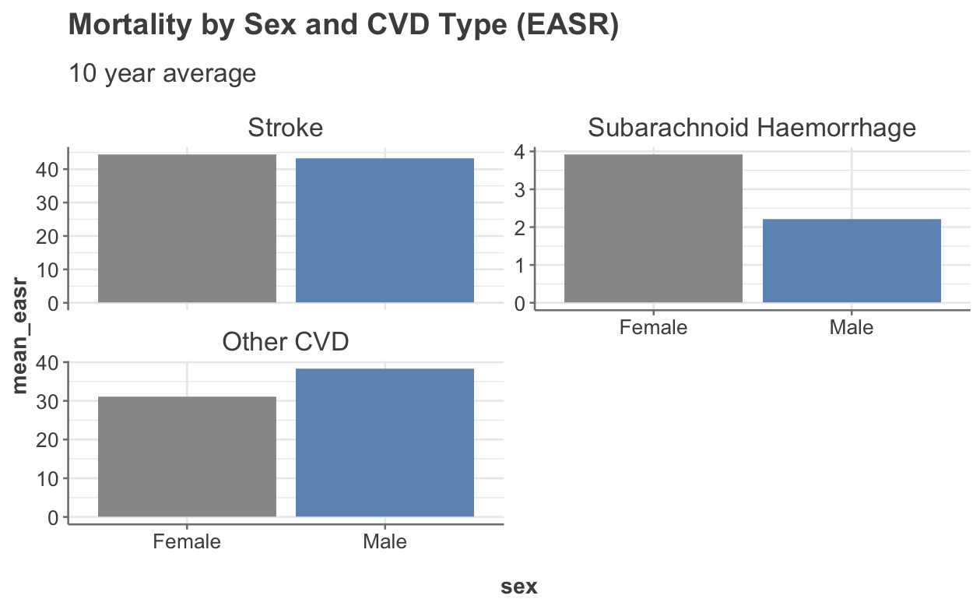
Type of CVD by Sex
?
hormonal influences
The effects of using raw data vs EASR is demonstrated
Do more woman than men suffer CVD? Yes but…
SAH – only type of CVD with female predominance
reproductive factors
variation in wall shear stress
References: https://www.ahajournals.org/doi/10.1161/01.STR.0000105933.16654.B4 & https://www.frontiersin.org/articles/10.3389/fneur.2012.00078/full

Slide 9
The above slide on sex is the one to run statistics on if there is time.

Slide 10
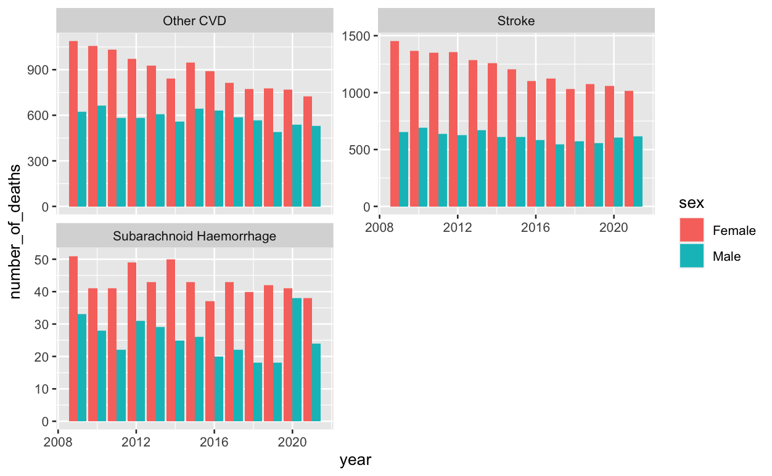
Mortality by sex
Shows pronounced spike in number of deaths for men in 2020. Not sure if this is interesting enough to spend time on.

Slide 11
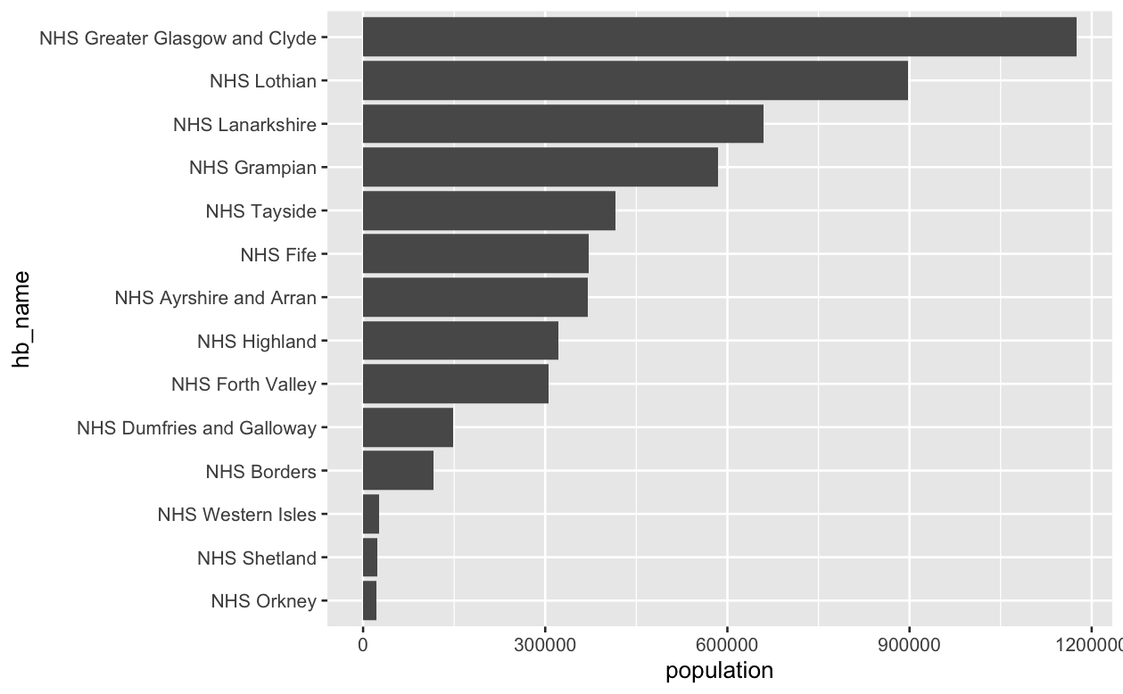
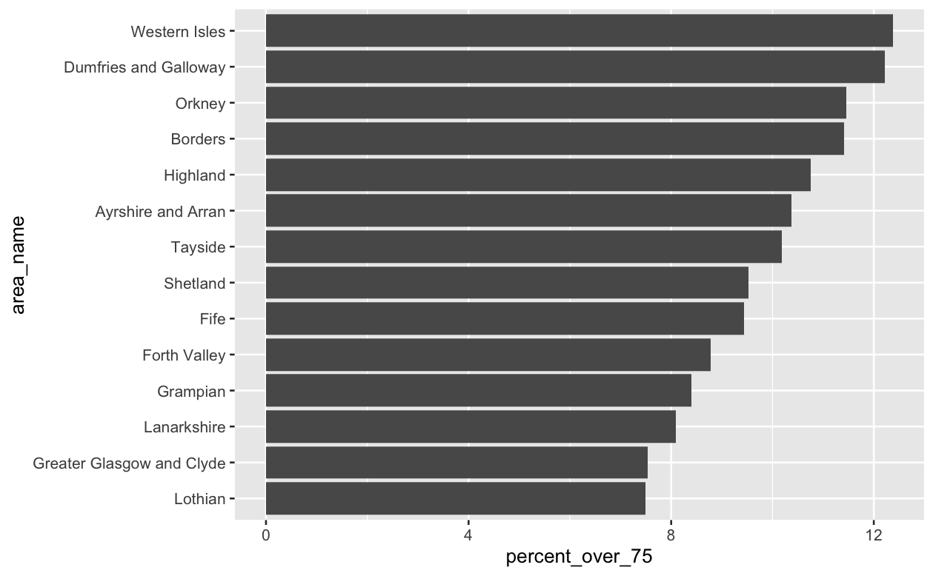
Health Board Information
Orkney smallest at 22190
Glasgow largest 1174980
Orkney is <2% size of Glasgow
We are reporting EASR values so these differences are accounted for
More rural areas have higher % over 75

Slide 12
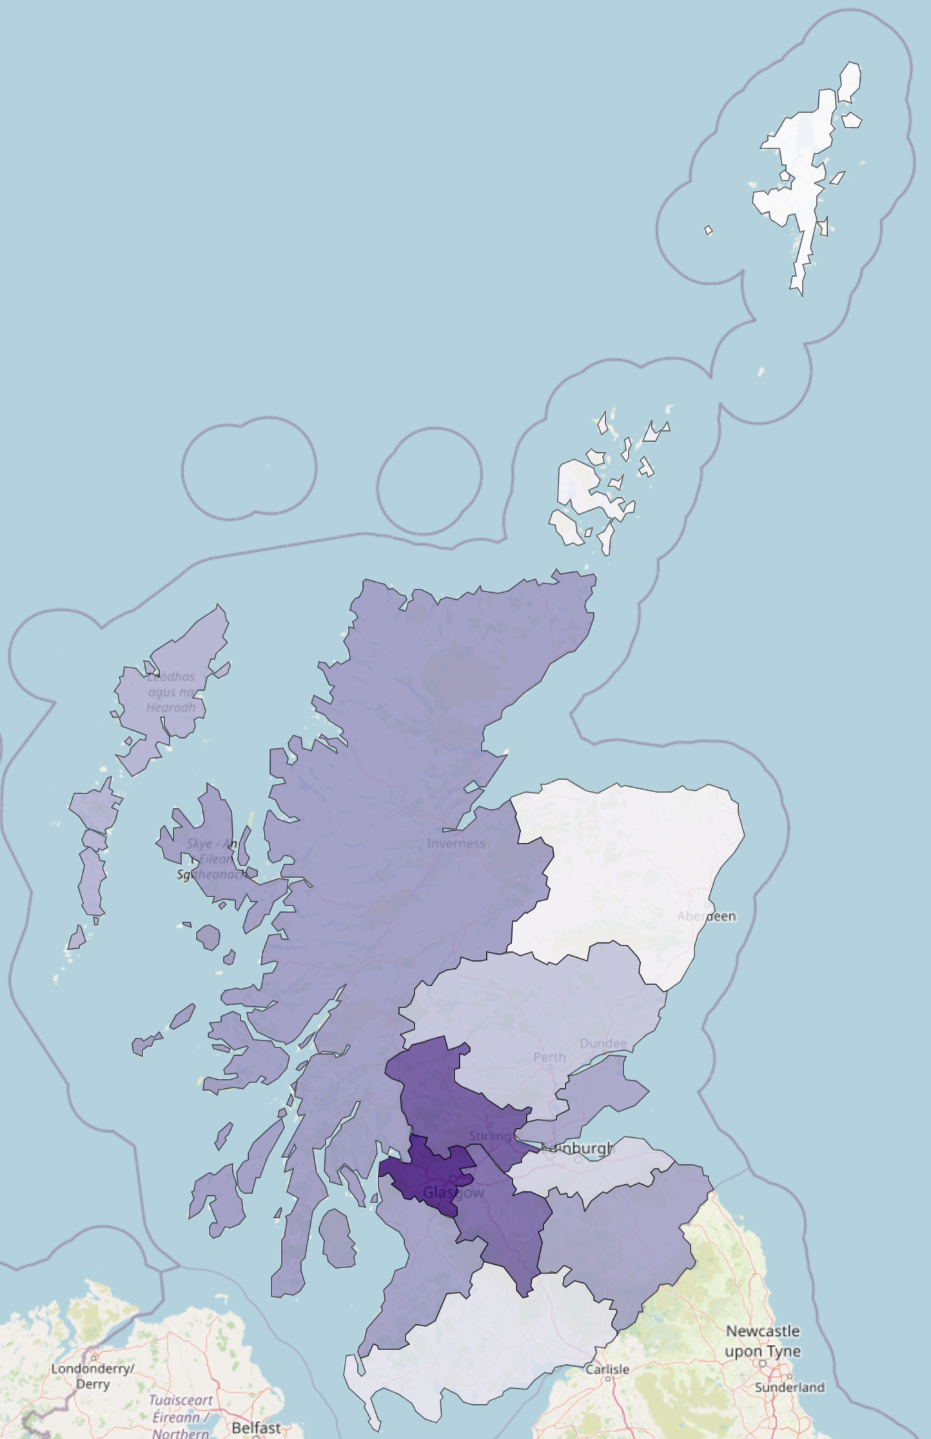
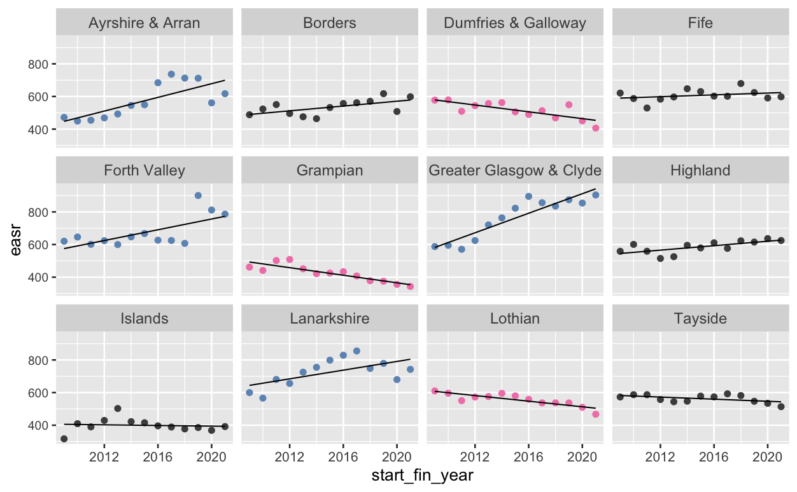
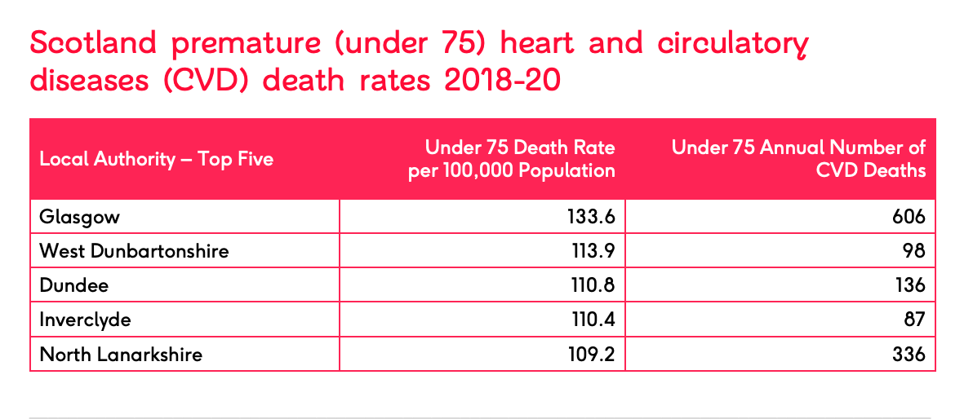

Health Board - Discharges
2021 Data
From PHS report:
“Over the past ten years, there was an increase in the adjusted discharge rate for stroke in all deprivation quintiles. The rate in the most deprived quintile increased by 39% compared to 21% in the least deprived quintile.”

Slide 13
Health Board – Incidences?

Slide 14
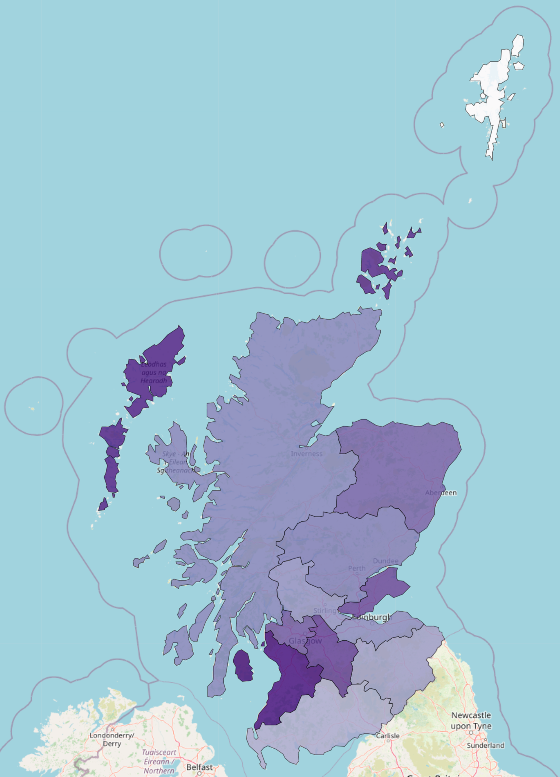
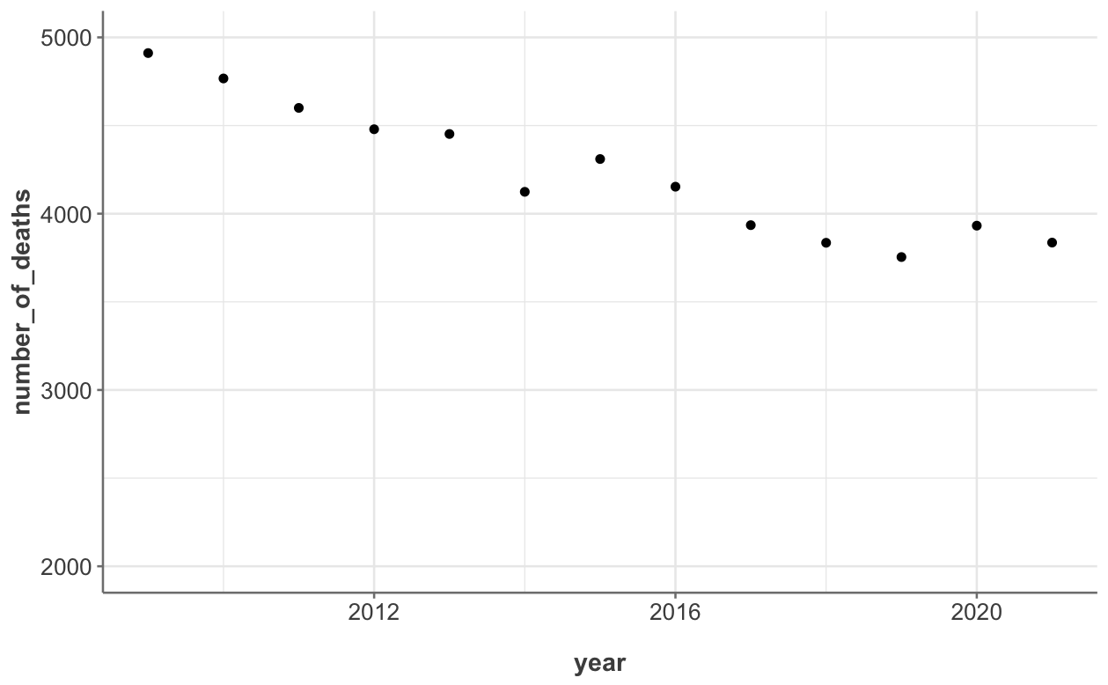
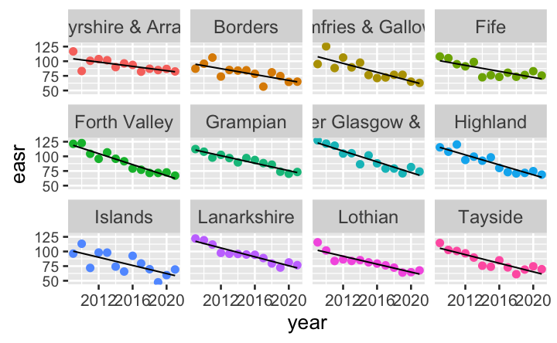
Health Board - Mortality
Group islands together for map
Mortality generally decreasing for all demographics
Some instances of rates going up but these are for categories with mortality rates < 10

Slide 15
The Journey to a ‘Beautiful’ Model
Multiple linear regression (manual)
R² = 31%
Random forest
R² = 97% but useless prediction
ARIMA – 13 years (13 data points) – not enough
Neural networks
Multiple linear regression (manual)
Variable engineering – log
Interactions
R2 – to be revealed
Multiple linear regression (glmulti)
Show this going round in a circle

Slide 16
Multiple Linear Regression – What to Build Model on?
Discharges
Mortality
Health Board
Council
Health Board
Council
Raw Values | Crude Rates | EASR
Raw Values | Crude Rates | EASR
Raw Values | Crude Rates | EASR
Raw Values | Crude Rates | EASR
Council – numbers were too low to form trend
Raw values and crude rates – would need to account for future changes in age structures of the population
2 Models
Focus on mortality model
Animate

Slide 17
Test-train split – didn’t do because of the nature of the data – only have one row per year per “category”. Tried holding back later years but predictions were bad because of covid effects.
What if we train model on years before covid – up to 2019?
Logged discharge and deaths
Added interactions – took R2 from 0.63 to 0.79

Slide 18
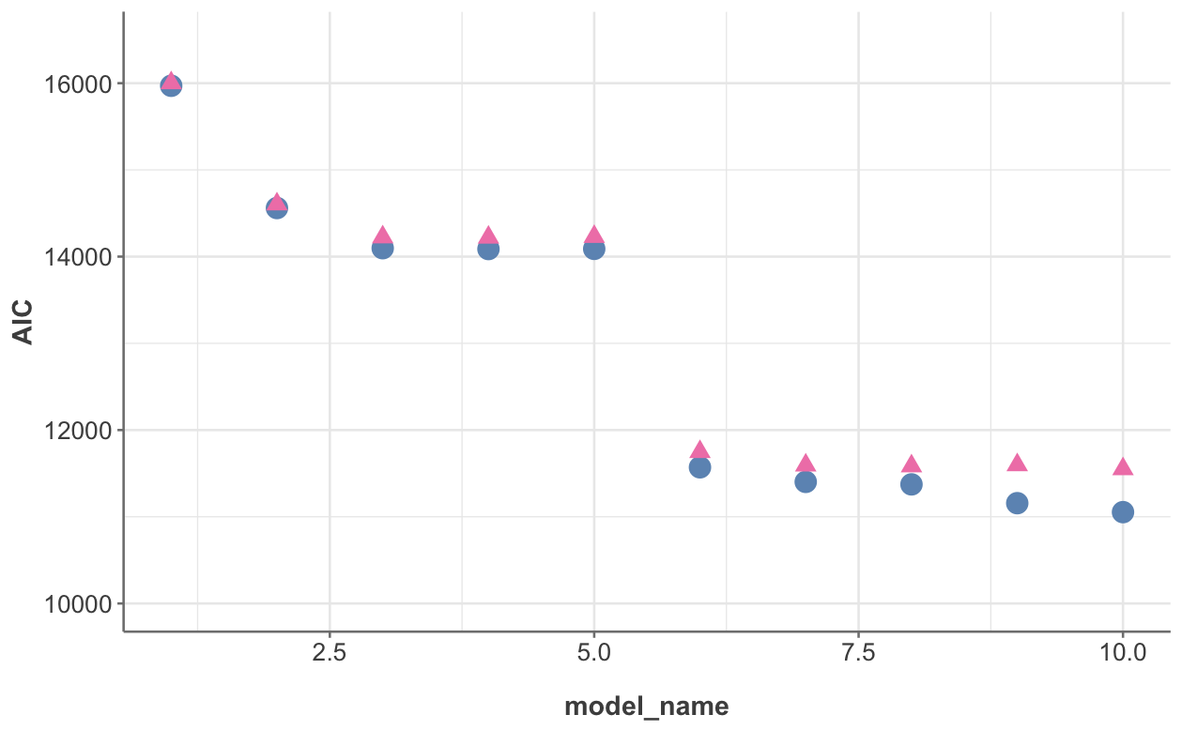
AIC and BIC
lm(log(1 + easr) ~ age + diagnosis + hbr_name + year + sex +
diagnosis:age + diagnosis:sex+ age:sex + age:hbr_name +
diagnosis:age:sex,
data = mortality_hb_for_fitting_easr

Slide 19
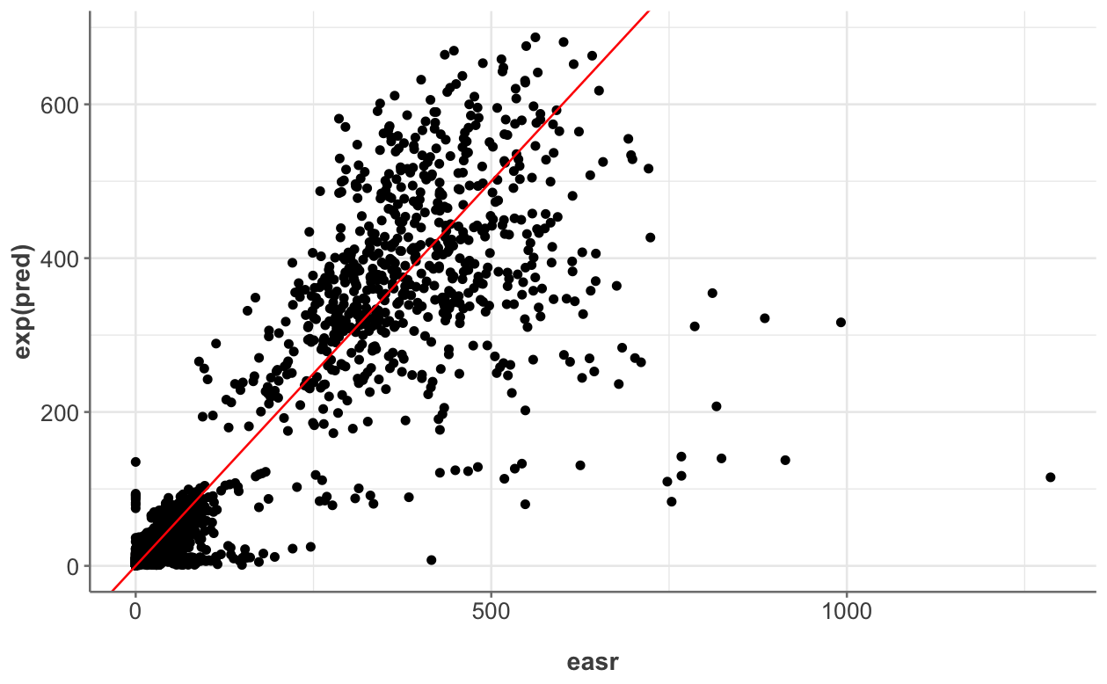
Real vs Model Values

Slide 20
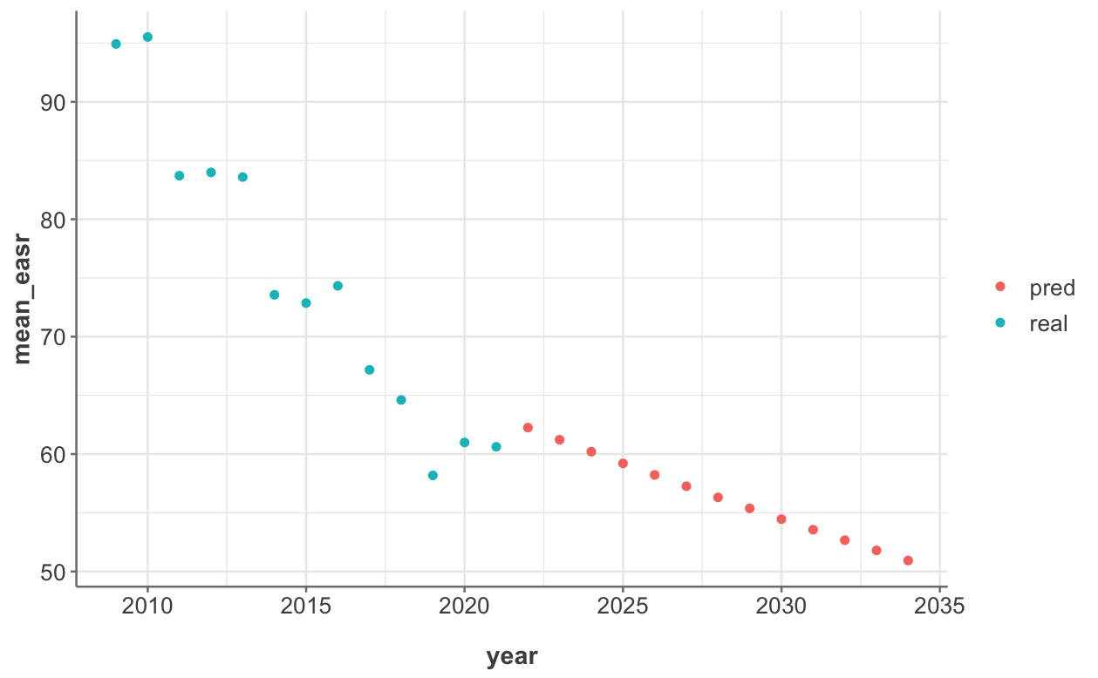

Slide 21
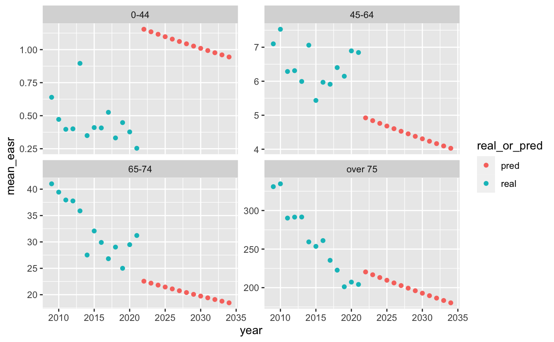
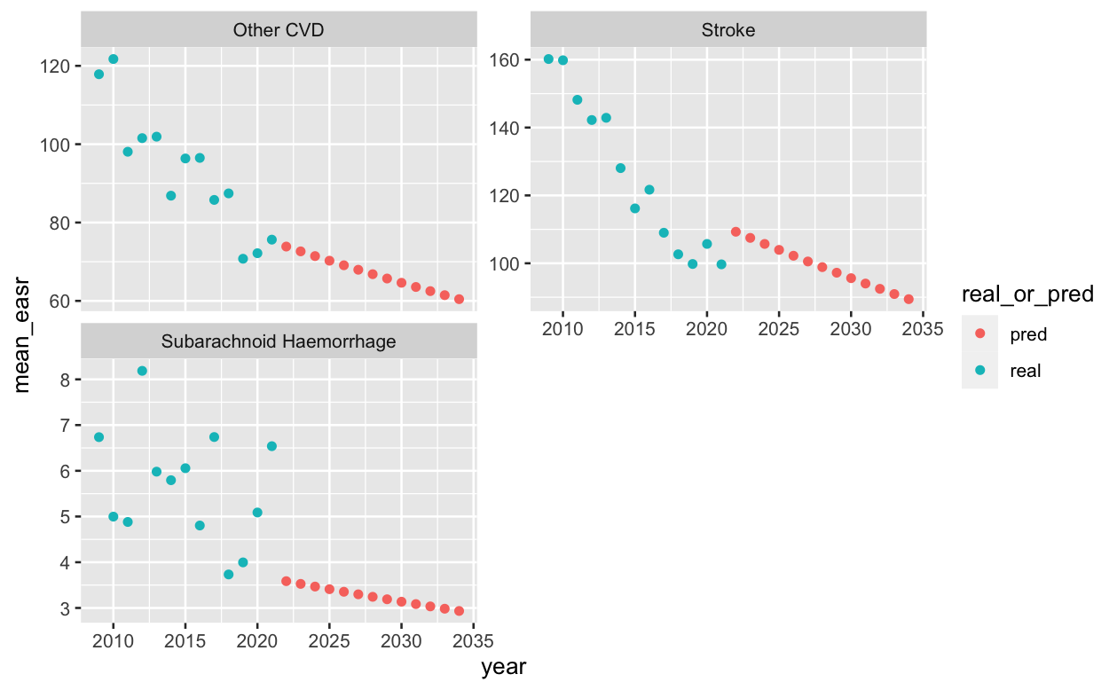
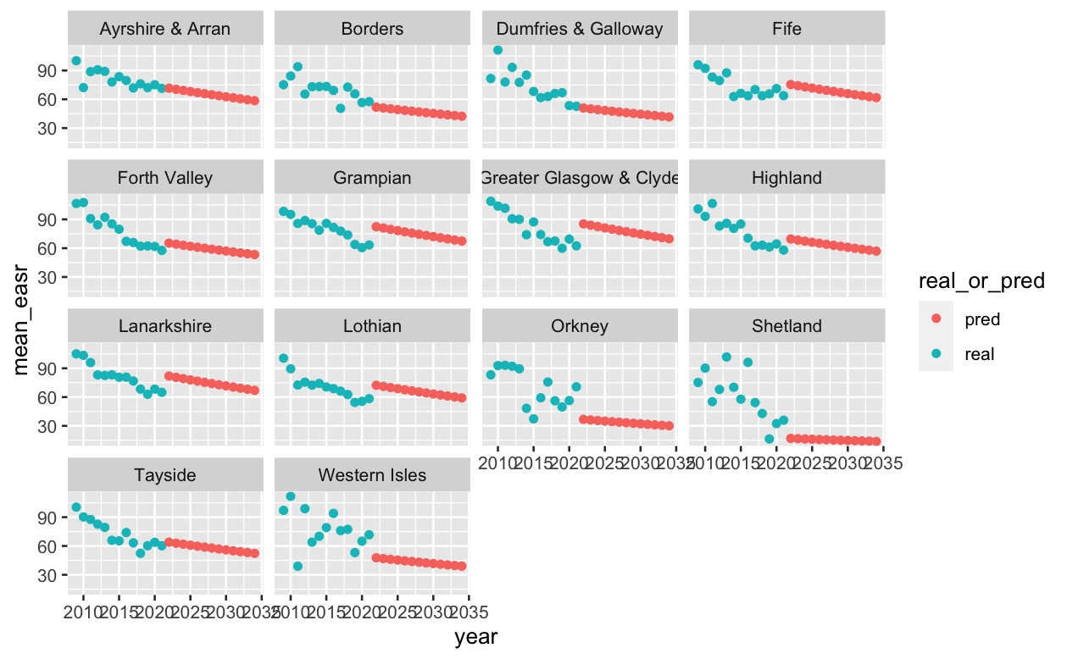
Future Predictions
Model good at predicting some categories…
…but not others
Groups with large numbers which are showing less good predictions

Slide 22
Ways to improve model?
Could predict at Scotland level? Is this any use?
No because year is insignificant.
Group islands together
Group emergency and transfer admission types
Split easr in to high values and low values

Slide 23
Future Work
Look at stroke risk factors and build model
Relate rates to deprivation levels in certain areas
Neural networks

Slide 24
Appendix 1 – Model Information

Slide 25
Appendix 2 – R2 in CVD Field
https://quantifyinghealth.com/r-squared-study/
analyzed the content of 43,110 randomly chosen research papers from PubMed to learn more about R-squared.
The average value of R-squared in medical research is 0.499, which means that the average linear regression model explains 49.9% of the outcome variance.
In typical applications in biology, psychology, marketing, and other domains, we would expect only a very small proportion of the variance in the response to be explained by the predictor, and an R2 value well below 0.1 might be more realistic!
An Introduction to Statistical Learning by Gareth James et al.
https://statisticsbyjim.com/regression/how-high-r-squared/
Any study that attempts to predict human behavior will tend to have R-squared values less than 50%.
However, if you analyze a physical process and have very good measurements, you might expect R-squared values over 90%.
Use prediction intervals to access precision
https://statisticsbyjim.com/regression/how-high-r-squared/

Slide 26
Health Board Age Structure
Could put in something about age structure but we are mostly reporting easr so is it really relevant??
Possible to create something similar

Slide 27
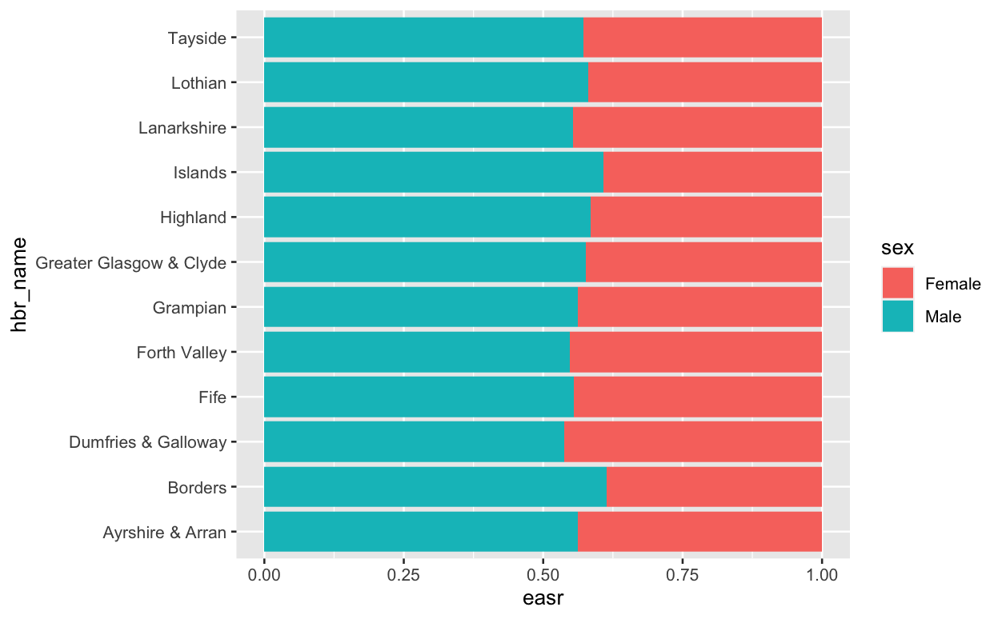
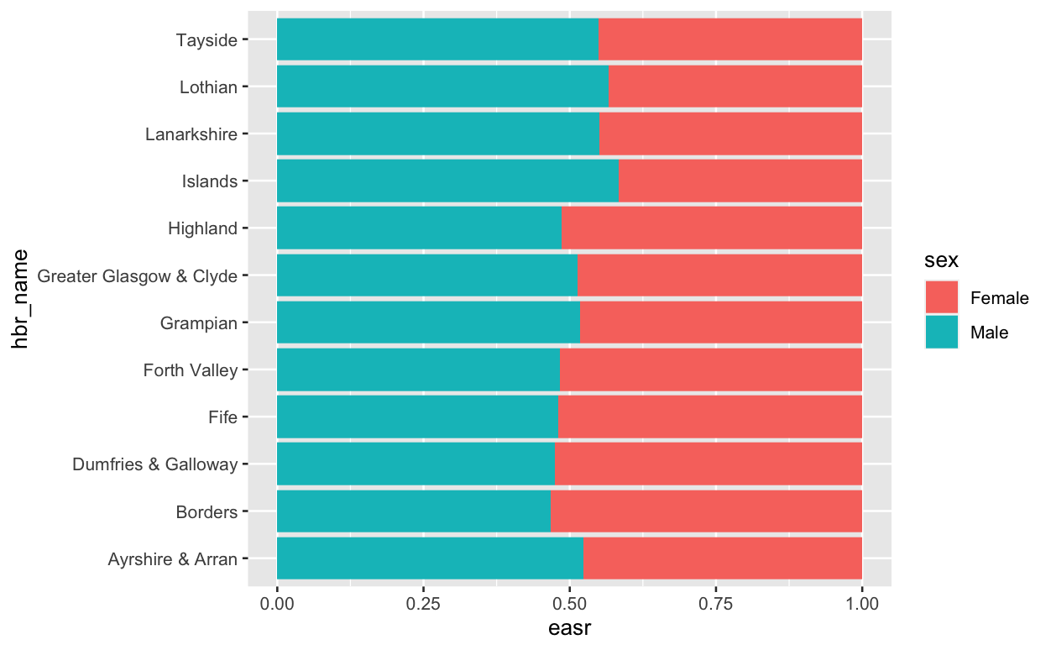
Looked at dischrages and deaths by sex and health board but nothing interesting popped up
Could do statistics on this – is the increase in borders significant??
What about age and health board – don’t the more deprived health boards have higher numbers.

Slide 28
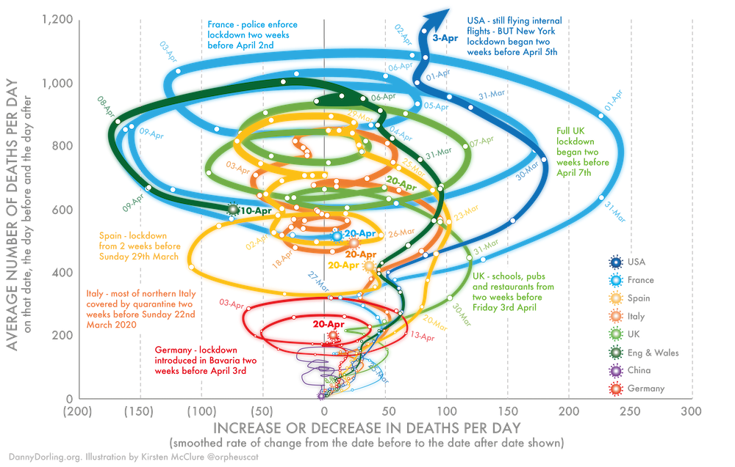
https://www.google.com/url?sa=i&url=https%3A%2F%2Ftheconversation.com%2Fthree-charts-that-show-where-the-coronavirus-death-rate-is-heading-137103&psig=AOvVaw0_3uQRiHl9VkVurSQsCgd8&ust=1676730548894000&source=images&cd=vfe&ved=0CA8QjRxqFwoTCLDm5ZfinP0CFQAAAAAdAAAAABAE

